Slide 1
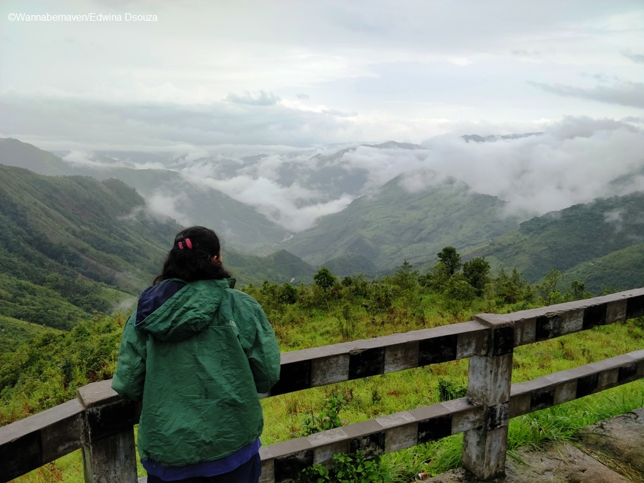

Travel Alert Bangladesh (TAB)
WELCOME TO OUR
“Where sophistication meets exploration”

Slide 2
discuss a tour event
Discussion Our Company
01
Discuss an Tour Event

Slide 3
Let's discuss an event in Meghalaya
Title:
Explore Meghalaya: The Scotland of the East
Dates:
September 19th to September 23th
Contact Information:
📞 01740271903 (WhatsApp Also)
✉️ travelalertBangladesh@gmail.com

Slide 4
Title
Tour Overview
Event Fee
From Dhaka: 💵 12,000 BDT
From Sylhet: 💵 10,800 BDT
Include
01
🚌 Non-AC Bus (Dhaka-Sylhet-Dhaka)
02
🚗 Laguna/CNG (Sylhet-Tamabil)
03
🚙 Luxury Car/Coach (Dawki-Cherapunji-Shillong)
01
🏨 2 Nights Hotel Accommodation

